Slide 1
chapter 9 Support Vector Machines

Slide 2
In this chapter, we discuss the support vector machine (SVM), an approach for classification that was developed in the computer science community in the 1990s and that has grown in popularity since then.
SVMs have been shown to perform well in a variety of settings, and are often considered one of the best “out of the box” classifiers.

Slide 3
maximal margin classifier support vector classifier support vector machine

Slide 4

9.1 Maximal Margin Classifier 9.1.1 What Is a Hyperplane?
In a p-dimensional space, a hyperplane is a flat affine subspace of dimension p − 1. For instance, in two dimensions, a hyperplane is a flat one-dimensional subspace—in other words, a line. In three dimensions, a hyperplane is a flat two-dimensional subspace—that is, a plane. In p > 3 dimensions, it can be hard to visualize a hyperplane, but the notion of a (p − 1)-dimensional flat subspace still applies.

Slide 5


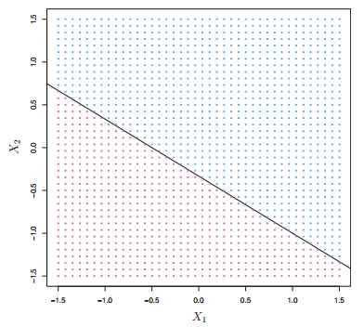

Slide 6
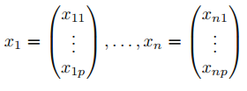
9.1.2 Classification Using a Separating Hyperplane
Now suppose that we have a n×p data matrix X that consists of n training observations in p-dimensional space, and that these observations fall into two classes—that is, y1, . . . , yn ∈ {−1, 1} where −1 represents one class and 1 the other class.
Our goal is to develop a classifier based on the training data that will correctly classify the test observation using its feature measurements.

Slide 7


Suppose that it is possible to construct a hyperplane that separates the hyperplane training observations perfectly according to their class labels. Then a separating hyperplane has the property that

Slide 8
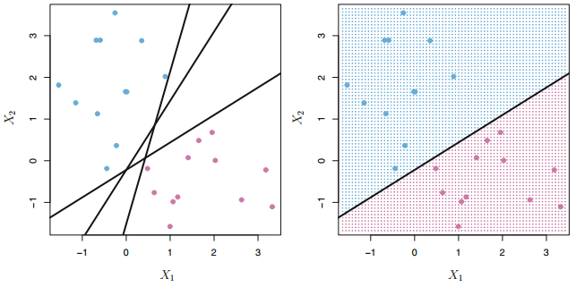

Slide 9
9.1.3 The Maximal Margin Classifier
In general, if our data can be perfectly separated using a hyperplane, then there will in fact exist an infinite number of such hyperplanes. This is because a given separating hyperplane can usually be shifted a tiny bit up or down, or rotated, without coming into contact with any of the observations. A natural choice is the maximal margin hyperplane (also known as the optimal separating hyperplane), which is the separating hyperplane that is farthest from the training observations.

Slide 10
The main idea
we can compute the (perpendicular) distance from each training observation to a given separating hyperplane; the smallest such distance is the minimal distance from the observations to the hyperplane, and is known as the margin.
The maximal margin hyperplane is the separating hyperplane for which the margin is largest—that is, it is the hyperplane that has the farthest minimum distance to the training observations.

Slide 11
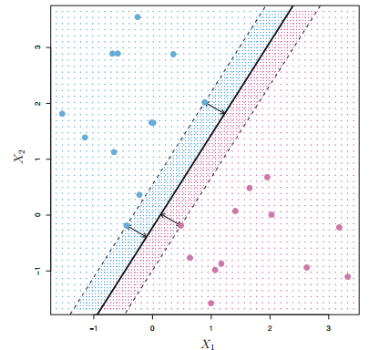

Slide 12
We can then classify a test observation based on which side of the maximal margin hyperplane it lies. This is known as the maximal margin classifier.
We hope that a classifier that has a large margin on the training data will also have a large margin on the test data, and hence will classify the test observations correctly.

Slide 13
Examining Figure 9.3, we see that three training observations are equidistant from the maximal margin hyperplane and lie along the dashed lines indicating the width of the margin.
These three observations are known as support vectors, since they are vectors in p-dimensional space (in Figure 9.3, p = 2) and they “support” the maximal margin hyperplane in the sense that if these points were moved slightly then the maximal margin hyperplane would move as well.

Slide 14
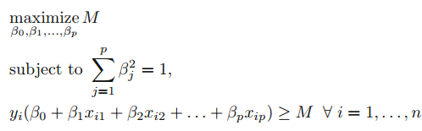
9.1.4 Construction of the Maximal Margin Classifier
Hence, M represents the margin of our hyperplane, and the optimization problem chooses β0, β1, . . . , βp to maximize M. This is exactly the definition of the maximal margin hyperplane!

Slide 15
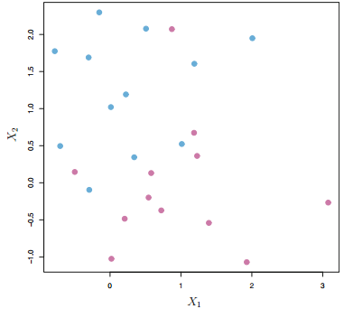
9.1.5 The Non-separable Case
In many cases no separating hyperplane exists, and so there is no maximal margin classifier.
we can extend the concept of a separating hyperplane in order to develop a hyperplane that almost separates the classes, using a so-called soft margin.

Slide 16
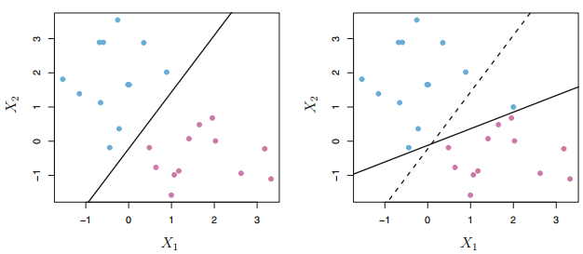
9.2 Support Vector Classifiers 9.2.1 Overview of the Support Vector Classifier
A classifier based on a separating hyperplane will necessarily perfectly classify all of the training observations; this can lead to sensitivity to individual observations.

Slide 17
In this case, we might be willing to consider a classifier based on a hyperplane that does not perfectly separate the two classes, in the interest of
• Greater robustness to individual observations, and • Better classification of most of the training observations. That is, it could be worthwhile to misclassify a few training observations in order to do a better job in classifying the remaining observations.

Slide 18
The support vector classifier, sometimes called a soft margin classifier, does exactly this.
Rather than seeking the largest possible margin so that every observation is not only on the correct side of the hyperplane but also on the correct side of the margin, we instead allow some observations to be on the incorrect side of the margin, or even the incorrect side of the hyperplane.

Slide 19
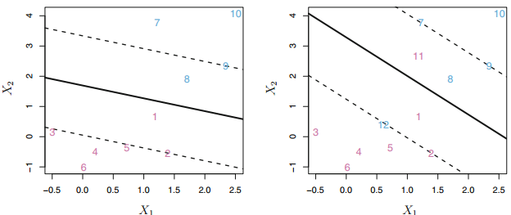

Slide 20
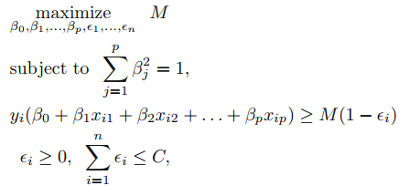
9.2.2 Details of the Support Vector Classifier
C is a nonnegative tuning parameter. Epsilon_1, . . . , Epsilon_n are slack variables that allow individual observations to be onthe wrong side of the margin or the hyperplane

Slide 21
The slack variable Epsilon_i
the slack variable Epsilon_i tells us where the ith observation is located, relative to the hyperplane and relative to the margin.
If Epsilon_i = 0 then the ith observation is on the correct side of the margin, If Epsilon_i > 0 then the ith observation is on the wrong side of the margin, and we say that the ith observation has violated the margin.
If Epsilon_i > 1 then it is on the wrong side of the hyperplane.

Slide 22
Tuning parameter C
Tuning parameter C bounds the sum of the Epsilon_i’s, and so it determines the number and severity of the violations to the margin (and to the hyperplane) that we will tolerate. We can think of C as a budget for the amount that the margin can be violated by the n observations. If C = 0 then there is no budget for violations to the margin, and it must be the case that Epsilon_1 = . . . = Epsilon_n = 0. For C > 0 no more than C observations can be on the wrong side of the hyperplane.

Slide 23
C controls the bias-variance trade-off
In practice, C is treated as a tuning parameter that is generally chosen via cross-validation.
C controls the bias-variance trade-off of the statistical learning technique. When C is small, we seek narrow margins that are rarely violated; this amounts to a classifier that is highly fit to the data, which may have low bias but high variance. On the other hand, when C is larger, the margin is wider and we allow more violations to it; this amounts to fitting the data less hard and obtaining a classifier that is potentially more biased but may have lower variance

Slide 24
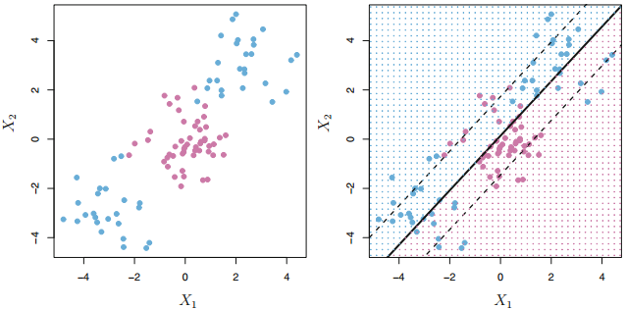
The fact that the support vector classifier’s decision rule is based only on a potentially small subset of the training observations (the support vectors) means that it is quite robust to the behavior of observations that are far away from the hyperplane.

Slide 25
9.3 Support Vector Machines 9.3.1 Classification with Non-linear Decision Boundaries
The support vector classifier is a natural approach for classification in the two-class setting, if the boundary between the two classes is linear. However, in practice we are sometimes faced with non-linear class boundaries.

Slide 26


In the case of the support vector classifier, we could address the problem of possibly non-linear boundaries between classes in a similar way, by enlarging the feature space using quadratic, cubic, and even higher-order polynomial functions of the predictors. For instance, rather than fitting a support vector classifier using p features
we could instead fit a support vector classifier using 2p features

Slide 27
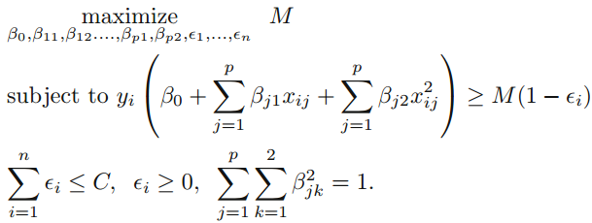

Slide 28
Why does this lead to a non-linear decision boundary?
In the enlarged feature space, the decision boundary that is in fact linear. But in the original feature space, the decision boundary is of the form q(x) = 0, where q is a quadratic polynomial, and its solutions are generally non-linear. It is not hard to see that there are many possible ways to enlarge the feature space, and that unless we are careful, we could end up with a huge number of features. Then computations would become unmanageable.

Slide 29
9.3.2 The Support Vector Machine
The support vector machine (SVM) is an extension of the support vector classifier that results from enlarging the feature space in a specific way, using kernels. we may want to enlarge our feature space in order to accommodate a non-linear boundary between the classes. The kernel approach that we describe here is simply an efficient computational approach for enacting this idea.

Slide 30
We have not discussed exactly how the support vector classifier is computed because the details become somewhat technical.
However, it turns out that the solution to the support vector classifier problem involves only the inner products of the observations (as opposed to the observations themselves).

Slide 31

It can be shown that
The linear support vector classifier can be represented as
where there are n parameters αi, i = 1, . . . , n, one per trainingobservation.
To estimate the parameters α1, . . . , αn and β0, all we need are the C_n^2 inner products <xi, xi’> between all pairs of training observations.

Slide 32

However, it turns out that αi is nonzero only for the support vectors in the solution—that is, if a training observation is not a support vector, then its αi equals zero. So if S is the collection of indices of these support points, we can rewrite any solution function as
To summarize, in representing the linear classifier f(x), and in computing its coefficients, all we need are inner products.

Slide 33




Now suppose that every time the inner product appears in the representation, or in a calculation of the solution for the support vector classifier, we replace it with a generalization of the inner product of the form

Slide 34
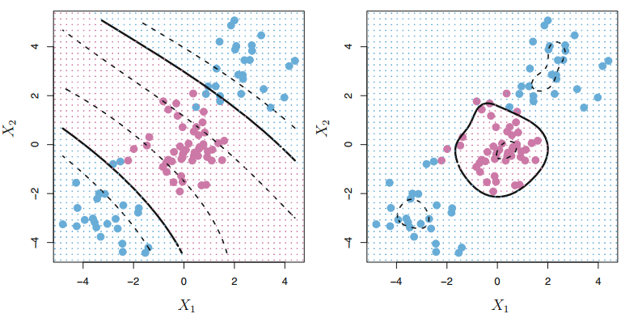

Slide 35
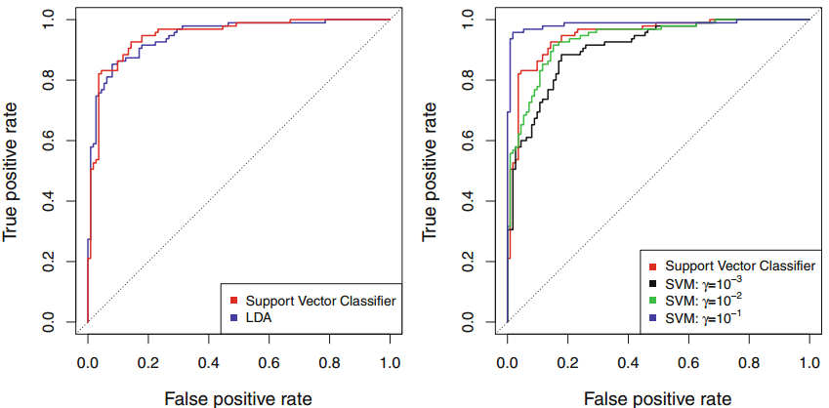
9.3.3 An Application to the Heart Disease Data

Slide 36
9.4 SVMs with More than Two Classes
9.4.1 One-Versus-One Classification For example, one such SVM might compare the kth class, coded as +1, to the k’th class, coded as −1.
9.4.2 One-Versus-All Classification We fit K SVMs, each time comparing one of all the K classes to the remaining K − 1 classes.

Slide 37
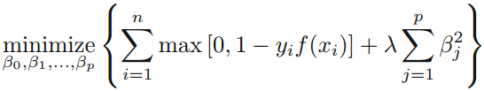
9.5 Relationship to Logistic Regression
An interesting characteristic of the support vector classifier is that only support vectors play a role in the classifier obtained; observations on the correct side of the margin do not affect it. This is due to the fact that the loss function is exactly zero for observations for which yi(β0 + β1xi1 + . . . + βpxip) ≥ 1; these correspond to observations that are on the correct side of the margin.

Slide 38
In contrast, the loss function for logistic regression is not exactly zero anywhere. But it is very small for observations that are far from the decision boundary. Due to the similarities between their loss functions, logistic regression and the support vector classifier often give very similar results. When the classes are well separated, SVMs tend to behave better than logistic regression; in more overlapping regimes, logistic regression is often preferred.

Slide 39
Is the SVM unique in its use of kernels to enlarge the feature space to accommodate non-linear class boundaries?
The answer to this question is “no”. We could just as well perform logistic regression or many of the other classification methods seen in this book using non-linear kernels; this is closely related to some of the non-linear approaches seen in Chapter 7.

Slide 40
9.6.1 Support Vector Classifier
set.seed (1)
x= matrix ( rnorm (20*2) , ncol =2)
y=c( rep ( -1 ,10) , rep (1 ,10) )
x[y==1 ,]= x[y==1 ,] + 1
plot(x, col =(3- y))
dat = data.frame (x=x, y=as.factor (y))
library ( e1071 )
svmfit =svm (y~., data=dat , kernel ="linear", cost =10, scale =FALSE )
plot(svmfit , dat )
summary ( svmfit )

Slide 41
set.seed (1)
tune.out = tune(svm ,y~., data=dat , kernel ="linear",
ranges =list (cost=c(0.001 , 0.01 , 0.1, 1 ,5 ,10 ,100) ))
summary (tune.out )
bestmod =tune.out$best.model
summary ( bestmod )

Slide 42
xtest = matrix (rnorm (20*2) , ncol =2)
ytest = sample (c(-1,1) , 20, rep = TRUE)
xtest [ ytest ==1 ,]= xtest [ ytest ==1 ,] + 1
testdat =data.frame (x=xtest , y=as.factor ( ytest ))
ypred = predict (bestmod , testdat )
table ( predict =ypred , truth = testdat$y )

Slide 43
9.6.2 Support Vector Machine
set.seed (1)
x= matrix ( rnorm (200*2) , ncol =2)
x [1:100 ,]= x [1:100 ,]+2
x [101:150 ,]= x[101:150 ,] -2
y=c( rep (1 ,150) ,rep (2 ,50) )
dat = data.frame (x=x,y=as.factor (y))
plot(x, col =y)
train = sample (200 ,100)
svmfit =svm (y~., data=dat [train ,], kernel ="radial", gamma =1,
cost =1)
plot(svmfit , dat [train ,])
summary ( svmfit )

